Slide 1
Conceptualizing and Assessing the Broader Impacts of Your Research
Miles McNall, PhD University Outreach & Engagement mcnall@msu.edu | Sobha Ramanand, PhD Research & Innovation ramanand@msu.edu
May 10, 2021
Notes:
MM: Hello, my name is Miles McNall, and I am here today with my colleague Dr. Sobha Ramanand. I am the Director for Community-Engaged Research in the office of University Outreach and Engagement. Dr. Ramanand is Research Specialist in the Office of the Vice President for Research and Innovation. Over the next two hours, we will be presenting information and guiding you through the process of creating the key elements of a Broader Impacts plan for your next NSF or other funding agency proposal.

Slide 2
Housekeeping
Please keep yourself muted
Use the chat box to ask questions
Feel free to take a break when needed
One 10-minute break in the middle
Make sure you have your worksheets handy!
Notes:
Before we get started, I’d like to go over our Zoom protocols…

Slide 3
Today’s Objectives
Gain a better understanding of how to design, implement and evaluation BI activities
Know where to go for BI resources and supports
Transform your thinking about BI
Burden
Opportunity
Notes:
Transform your thinking about BI: If you currently see BI as a burden, by the end of the workshop we hope you see it as an exciting opportunity instead.

Slide 4
BI Basics
What are broader impacts?
Why are they important?
Notes:
Let’s start with the basics: What are broader impacts and why are they important?
Although we will be speaking today within the framework and language of the National Science Foundation and the National Alliance for Broader Impacts (better known as NABI), many of the general points we will be making are more broadly applicable across several funding agencies.

Slide 5
Two NSF proposal review criteria:
Intellectual Merit
Broader Impacts
The potential for the proposed activity to advance knowledge and understanding within its own field or across different fields
The potential for the proposed activity to benefit society or advance desired societal outcomes

Slide 6
Achieving Broader Impacts
Broader impacts are accomplished through:
The research itself
Activities directly related to specific research projects
Activities supported by, but complementary to the project
Notes:
Broader impacts can be achieved in three ways:
Through the research itself. It’s possible your research itself will have a direct benefit to society.
Activities directly related to specific research projects, such as increasing the number students and postdocs working in your lab from historically underrepresented groups.
Activities that are complementary to a research project, such as developing interactive activities for the MSU science festival that teach some of the fundamental scientific concepts behind your research to public audiences.

Slide 7
Why are Broader Impacts important?
“…we need to engage the public in order to help improve understanding of the value of basic research and why our projects are worthy of investment.”
France A. Córdova, past NSF Director

Slide 8
Why are broader impacts important?
“While a great Broader Impacts statement won’t float a proposal with poor science, a poor Broader Impacts statement can sink a proposal with good science.”
Jennifer deBruyn, 2018
Notes:
From a more practical perspective, a poor BI plan can sink an otherwise good proposal.

Slide 9
Where do BI appear in my proposal?
Project Description: A section labelled “Broader Impacts”
Special Information and Supplementary Documentation
Postdoc Mentoring Plan
Data Management Plan
Letters of Collaboration
Biosketch
Budget & Justification
Annual Report

Slide 10
BI Examples

Slide 11
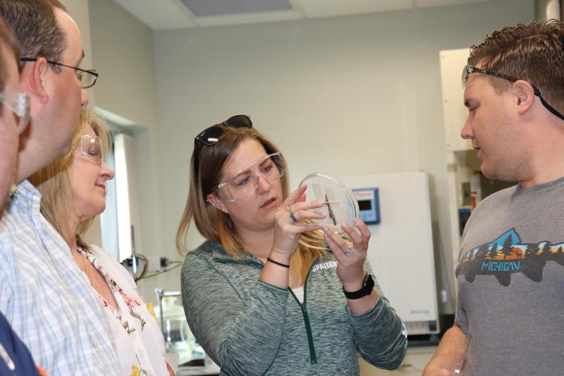
Research Experience for Teachers (RET)
College of Engineering
Wen Li and Drew Kim
Middle and High School Teachers
Six-week Summer Institute
Participate in cutting-edge research
One-on-one mentoring by MSU graduate students and faculty
Development of innovative curriculum modules for classrooms
BI Goal: Improved STEM education and educator development at any level
Notes:
This is one of my favorite examples of a BI activity on this campus.
What are some of the broader impacts of this activity? (Put your answers in the chat)

Slide 12
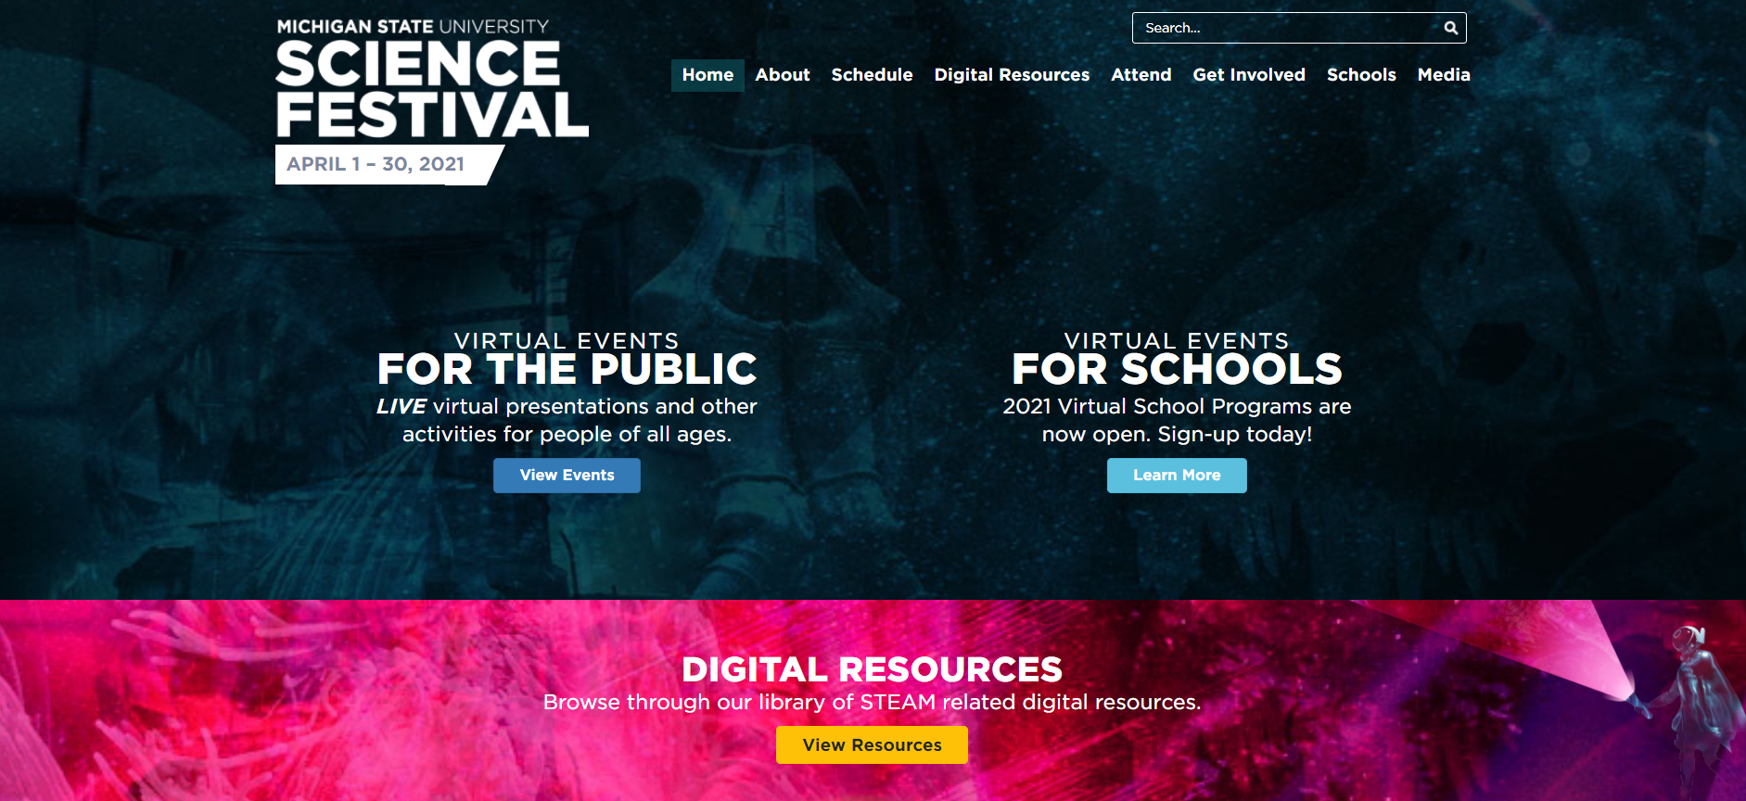
MSU Science Festival
Plan to get involved in April 2022!
https://sciencefestival.msu.edu/get-involved
Notes:
Another of my favorite examples is something that is very easy to get involved in.
All you need is a compelling presentation or hands-on demonstration.
If you haven’t already done so, consider getting involved in 2022.
And the website has lots of great tips for engaging the public in your science!

Slide 13
Core Elements of a BI Plan
Goals
Audiences
Partners & Settings
Activities
Budget
Evaluation
BI PLAN
Notes:
This workshop is organized around the six core elements of a sound BI plan [read tiles, but don’t elaborate].
There is no necessary sequence. You can start with goals, audiences, settings, partners or activity.
You have worksheets to help you build your BI in 5 of 6 areas.

Slide 14
BI Goals
What impacts do you want your research to have?
Notes:
MM: Let’s start with goals, or the impacts you want your research to have on society.

Slide 15
BI Goals
Full participation of women, persons with disabilities, and underrepresented minorities in science, technology, engineering, and mathematics (STEM)
Improved STEM education and educator development at any level
Increased public scientific literacy and public engagement with science and technology
Improved well-being of individuals in society
Development of a diverse, globally competitive STEM workforce
Enhanced infrastructure for research and education
Increased partnerships between academia, industry, and others
Increased economic competitiveness of the United States
Improved national security
Notes:
NABI identified 9 broad BI goal areas…

Slide 16
Broadening Participation
Problem: “…non-dominant populations in the US have been significantly underrepresented in STEM academics, professions, and civic decision-making…” (Bevan, Calabrese Barton & Garibay, 2018).
Goal: full participation of women, persons with disabilities, and underrepresented minoritized groups in science, technology, engineering, and mathematics (STEM)
Notes:
SR: Because broadening participation is among the most common BI goals, I’d like to spend a minute on it.

Slide 17
Broadening Participation
For underrepresented groups, it is not enough to simply increase access to existing STEM opportunities
STEM opportunities designed for dominant-culture populations may not be appropriate for underrepresented groups
Work with community partners and intended participants to design culturally responsive STEM opportunities
(More about this in the Partnerships section)
Bevan, Calabrese Barton & Garibay, 2018

Slide 18
MSU Partners for Broadening Participation
Graduate School. Steven Thomas, Program Manager for:
Alliance for Graduate Education and the Professoriate (AGEP)
Summer Research Opportunities Program (SROP)
Center for Academic & Future Faculty Excellence (CAFFE)
College of Engineering Diversity Programs Office - Kyle Foster, Director
Michigan Louis Stokes Alliance for Minority Participation (MI-LSAMP)
GEM Fellowship
College Access Initiatives - Dr. Stephanie Anthony, Director
Educational Talent Search
Upward Bound
King-Chavez-Parks
Gear Up
College of Agriculture and Natural Resources - Stephanie Chau, Asst. Director for Undergraduate Diversity
Summer Youth Program for Indigenous Youth
Co-Advisor for MSU Chapter of Minorities in Agriculture, Natural Resources and Related Sciences (MANRRS)
MSU chapters of national organizations focused on diversity in STEM:
American Indian Science and Engineering Society (AISES)
Minorities in Agriculture, Natural Resources and Related Sciences (MANRRS)
National Society of Black Engineers (NSBE)
R Ladies
Spartan Girls who Code
Society for Advancement of Chicanos/Hispanics and Native Americans in Science (SACNAS)
Society of Women Engineers
Women in Microbiology
Women Chemists Committee ACS
Notes:
MSU is blessed with a huge array of resources to support broadening participation activities.

Slide 19
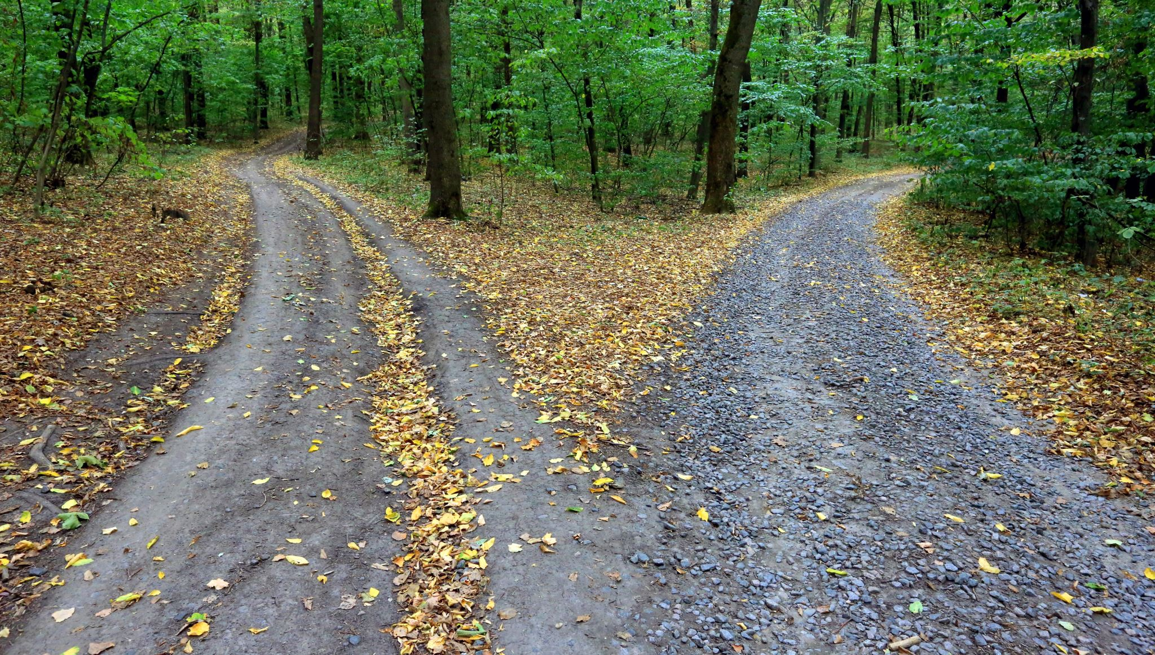
Poll: Your BI Goals
Notes:
MM: Let’s do a quick poll to find out what your broader impact goals are. Pick as many as you like.

Slide 20
Your Impact Identity
Notes:
MM: Now let’s consider something called your impact identity

Slide 21
How to Maximize Your Broader Impacts
Impact Identity
Impact Goals
Long-Term Plan
Supports and Resources
Source: Risien & Storksdieck, 2018
Notes:
Risien and Storksdieck argue that researchers maximize their ability to achieve broader impacts when they have:
Articulated their impact identity
Defined their impact goals
Developed a long-term plan to achieve them
Have the necessary supports and resources to carry out their BI activities

Slide 22
Scholarship & Research
Scientific Discipline
Societal Needs
Impact Identity
Notes:
Your impact Identity is located where the driving questions of your discipline and your own and scholarship intersect with urgent societal needs.

Slide 23
Personal Preferences
Scientific Discipline
Societal Needs
Scholarship & Research
Adapted from Risien & Storksdiek, 2018
Notes:
It is located where those questions and needs intersect with your personal preferences for audiences and activities.
What kinds of audiences do you like to interact with? Children or adults?
What kinds of broader impact activities do you find personally rewarding?

Slide 24
Personal Preferences
Scientific Discipline
Capacities and Skills
Scholarship & Research
Societal Needs
Adapted from Risien & Storksdiek, 2018
Notes:
Capacities and skills are another important element of your Impact Identity
What special talents or skills do you possess that will enable you to achieve broader impacts?
Are you an effective science communicator?
Are you skilled at creating hands-on activities that demonstrate key scientific principles?
Are you more skilled working with children or adults?
Do you have experience working with particular underrepresented groups?
If you don’t have a capacity or skill that is necessary for the BI activity you envision, who can you partner with who does?

Slide 25
Personal Preferences
Scientific Discipline
Capacities and Skills
Scholarship & Research
Institutional Context
Societal Needs
Adapted from Risien & Storksdiek, 2018
Notes:
The institutional context in which you operate is another key component of your Impact Identity.
To what extent does it provide a supportive environment for developing the societal impacts of your research?

Slide 26
Capacities and Skills
Scholarship & Research
Scientific Discipline
Personal Preferences
Institutional Context
Societal Needs
Impact Identity
Adapted from Risien & Storksdiek, 2018
Notes:
Together, these elements contribute to your impact identity and the broader impacts of your research on society.

Slide 27
Thinking Long Term
5 Years
25 Years
What will my impact legacy be?
What is my plan for achieving it?
Notes:
In thinking about your impact identity, it is important to think long term.
Not just where you will be in five years, but in 25.
Ask yourself:
What will my impact legacy be?
At the end of my career, what would I like to be remembered for?
What is my plan for getting there?

Slide 28
Scholarship & Research
Scientific Discipline
Societal Needs
Your Broader Impacts
Notes:
To get a handle on your impact identity, let’s first consider potential broader impacts at the intersection of your discipline, your scholarship, and urgent societal needs.

Slide 29
Worksheet 1: Impact Identity (10 min)
What are the leading questions in my discipline?
What questions drive my own research?
Where do the leading questions of my discipline and my own scholarship intersect with urgent societal needs? (Consider the nine NSF BI Goals).
What societal need(s) would I like to address through my BI activities?
What specific impact(s) would I like to achieve?
POST YOUR QUESTIONS IN THE CHAT!
Notes:
Now back to the worksheet.

Slide 30
Questions?

Slide 31
BI Audiences*
What audiences will you engage?
*audience implies passive one-way reception of scientific information
Notes:
SR: Given your desired impacts, what audiences will you need to engage to achieve them?

Slide 32
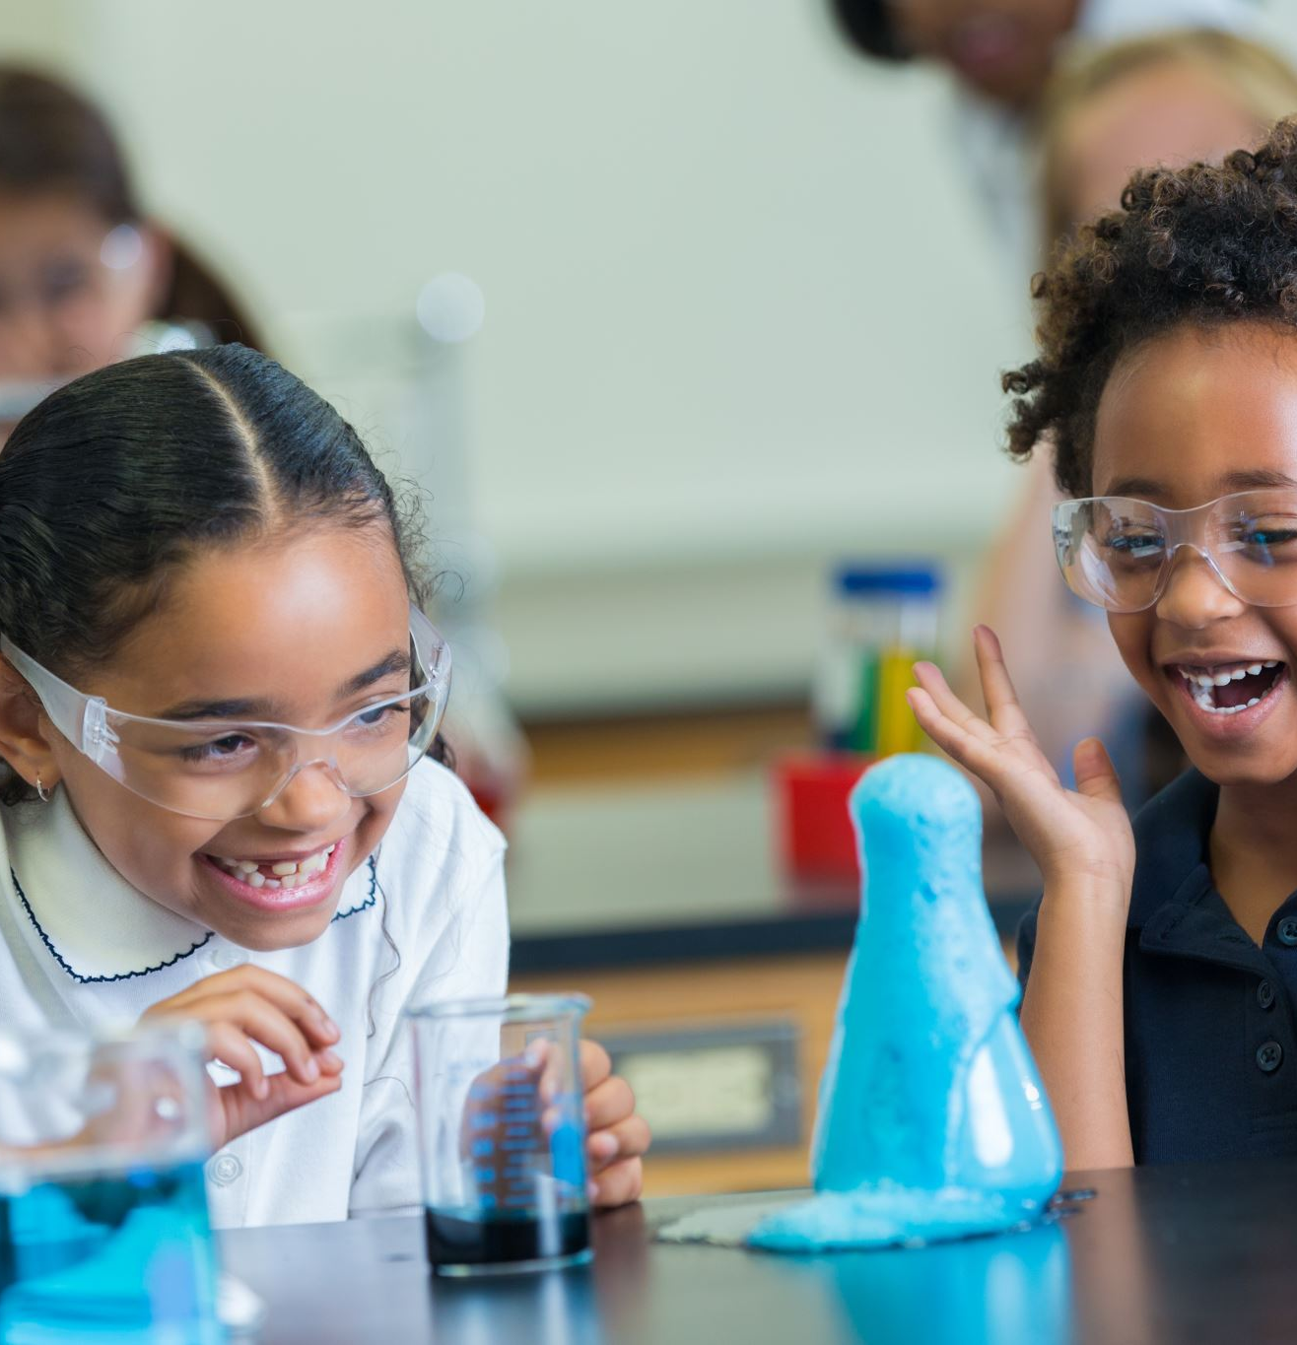
BI Audiences or Populations
Underrepresented in STEM populations
K-12 Students
K-12 Teachers
Lifelong Learners
General public
Hobbyists
Citizen Scientists
Industry
Government and Policymakers
Notes:
The are many audiences or populations you might engage to achieve your broader impacts. Here are a few.
You can probably think of others as well.
Which of these are you most interested in engaging? [Poll 2]
RESHARE screen

Slide 33
Choosing An Audience for BI
Notes:
Video: 3:02 minutes

Slide 34
Be Specific About Your Audience
Demographics
Location
Ages
Gender
Race/Ethnicity
Income
Numbers: How many?
Rationale: Why is it important to work with this audience?
Recruitment: How will you reach them?
Benefits: How will they benefit?
UNDERREPRESENTED GROUPS?
Notes:
When you put pen to paper and write your BI plan, you need to be specific about your intended audience and include the following information.

Slide 35
Outreach & Engagement Support
How comfortable or competent are you in working with your target audiences?
K-12 students or teachers?
Minoritized and historically marginalized groups?
Members of the general public with low scientific literacy?
Policymakers?
Notes:
One thing to think about when considering your BI audience or population is how comfortable or competent you feel in working with them…

Slide 36
Engagement Support
If you lack experience working successfully with your target audiences, ask for help!
University Outreach & Engagement (engage.msu.edu)
K-12 Outreach (education.msu.edu/k12/)
MSU Extension (canr.msu.edu/outreach)
MSU Innovation Center (innovationcenter.msu.edu)
IPPSR (ippsr.msu.edu) – working with policymakers
Faculty or staff with prior experience
Notes:
If you lack experience working successfully with your target audiences, there are lots of places to go for help.

Slide 37
Worksheet 2: My Audiences (10 mins)
What are some possible audiences for my BI activities?
Why is it important to work with these audiences?
POST YOUR QUESTIONS IN THE CHAT!
Notes:
Now, given your goals, what are some possible audiences for your BI activities?
And why is it important to engage with them? How will they benefit?

Slide 38
Questions?

Slide 39
BI Settings
Where will you engage with your audiences?
Notes:
MM: Now let’s consider where you will likely engage with your target audiences.

Slide 40
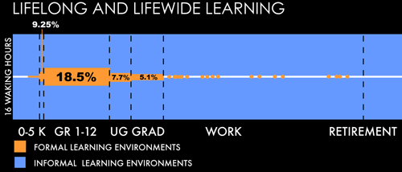
Lifelong Science Learning
Figure 1: The LIFE Center Lifelong and Lifewide Learning Diagram
Source: LIFE Center: Stevens, R. Bransford, J. & Stevens, A., 2005
Notes:
As this graph shows, throughout a person’s lifetime, less than 1/3 of their science learning will occur in formal science education settings.
Most of their science learning will occur in informal learning environments such as museums, science centers, etc.
Informal science education settings are one of the most common settings for BI activities.

Slide 41
SCIENCE EDUCATION SETTINGS
FORMAL | INFORMAL
Classrooms Laboratories Online courses | Designed Spaces Museums Science centers Zoos Aquariums Environmental centers
 | Programs for Science Learning Hobbyist groups Citizen science Library programs Making and tinkering groups Outdoor and garden programs Summer programs
 | Science Media Radio, TV, internet (interactive and online games, simulations, websites, mobile apps, etc.)
Source: Bell et al., 2009
Notes:
As this table shows, compared to formal science education settings, informal settings are quite varied.
There are three main categories of ISE settings:
Designed spaces…
Programs for Science Learning…
Science Media…

Slide 42
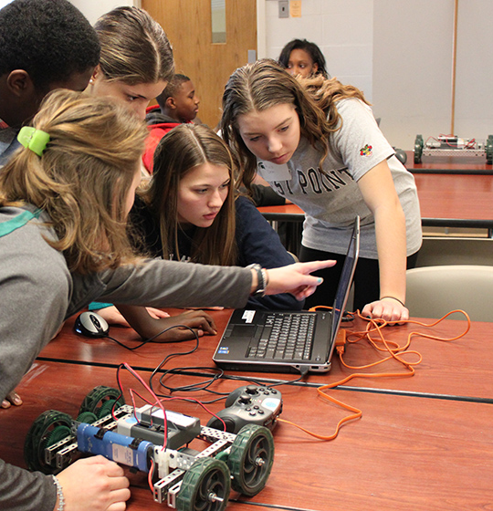
Summer Pre-College Programs
Spartan youth programs:
Spartan Robotics Camp
Math, Science, Technology Leadership Camp
Physics of Atomic Nuclei (PAN)
OsteoCHAMPS
ANR Institute for Multicultural Students
https://spartanyouth.msu.edu/Default.aspx
https://www.egr.msu.edu/index.php/news/2019/04/16/summer-camps-2019
Notes:
One hugely popular informal education setting for K-12 audience is MSU’s extensive summer pre-college programming for youth.
Here are just a few of the many examples…
You can find out more about them by going to the SYP website.

Slide 43
Science Media
Print: Scientific American, NY Times science supplement
Radio - NPR: Science Friday, Hidden Brain
TV – PBS: NOVA, Nature
Internet
Interactive and online games and simulations
Websites
Mobile apps – iNaturalist
Podcasts
Radio Lab
Star Talk
Science Vs
Notes:
Science communication occurs across a vast array of media, reaching audiences in nearly every demographic, from young children to seniors. Some examples are…

Slide 44
SciCom @ MSU
Science Communication Resources
AgBio Research – Science Communication Resources
MSU Libraries – Science Communication Guide
MSU SciComm (student organization)
Dave Poulson, Environmental Journalism
University Communications Toolbox
WKAR
At-home learning
Serving up Science hosted by Sheril Kirshenbaum
Notes:
As you might expect, there a many wonderful SciCom resources available at MSU.
Here are a few of them.

Slide 45
Worksheet 2: BI Settings (5 min)
Quickly jot down some ideas:
Given my goals and audiences, what are some possible settings for my BI activities?
Informal or formal?
Virtual, in-person, or hybrid?
Synchronous or asynchronous?

Slide 46
Questions?

Slide 47
BI Partners
Who will you partner with to design and implement your BI activities?
Notes:
SR: Next, we consider your BI partners. Who will you partner with to design and implementation your BI activities?

Slide 48
BI Partners
Given your BI audience, who are your likely BI partners?
Source: https://www.museum.msu.edu/?exhibition=sos
Notes:
The partners you select depends entirely on the audience(s) or populations you are trying to reach.
Who has established relationships with those audiences?
Science on a Sphere at MSU Museum.

Slide 49
BI Partners: Key Questions
Who are your partners?
Why are they the appropriate partners for this activity? What do they bring to the table? (experience, access to audience and setting, resources…)
How will you work together to achieve your goals and objectives?
How will partner roles be defined? (e.g., Co-PI, Key personnel, other…?)
What commitments am I making for myself and my institution? What commitments are my partners making? Will there be a signed agreement or MOU?
Source: Broader Impacts Wizard
Notes:
Here are some key questions about your partners from the BI Wizard…

Slide 50
Possible MSU Connectors and Partners
Offices Supporting Engagement | Designed Spaces
University Outreach & Engagement | Abrams Planetarium
Ctr for Community-Engaged Learning | MSU Museum
Director of Youth Programs | MSU Science Festival
Gifted and Talented Education | Science Gallery Lab Detroit
MSU Detroit Center | MSU Bug House
MSU Extension | MSU Horticulture Gardens
Office of K-12 Outreach | Tollgate Farm
Undergraduate Research | Kellogg Bird Sanctuary
College Access Initiatives
Research Centers | Science Media
Create for STEM Institute | WKAR Public Media
Julian Samora Research Institute
Native American Institute
Notes:
Here is a sample of some of your potential MSU connectors and partners. There are many more.
In the “offices supporting engagement” and “research centers” section, you will find MSU staff who can help connect you with specific audiences and populations.
In the designed spaces and science media sections you will find settings for connecting to broad audiences of various ages and backgrounds.

Slide 51
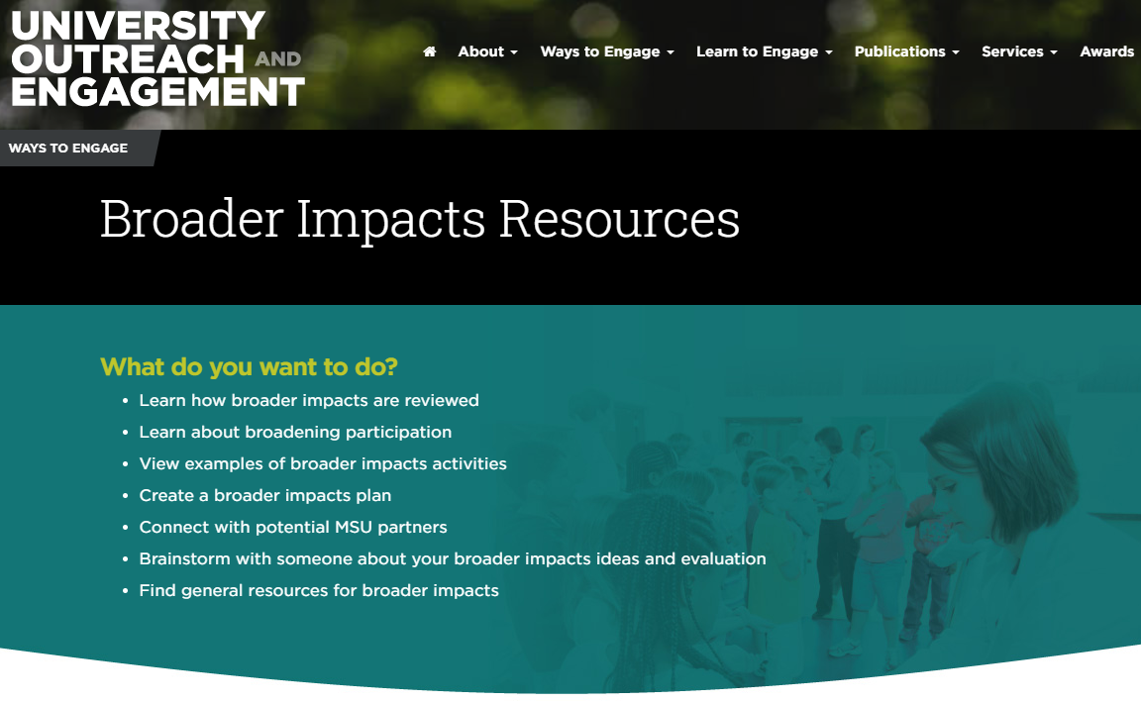
Finding MSU Partners
https://engage.msu.edu/ways-to-engage/broader-impacts-resources
Notes:
The UOE BI website contains a link to potential MSU partners.

Slide 52
Worksheet 3: My BI Partners (5 min)
Quickly jot down some ideas:
Who are some possible partners for my BI activities?
Why would they be appropriate partners for the goals and audiences I have in mind?
How do I connect with them?

Slide 53
Questions?

Slide 54
10-Minute Break
Notes:
MM: It is time now for a 10-minute break. We will see you back at….

Slide 55
Your BI Activity
Given your goals, audiences, settings and partners, what will you do together?*
*This should be decided in collaboration with your partners.
Notes:
MM: Now we consider your BI activity. Given your goals, audiences, settings and partners, what will you do together?
Given the vast universe of potential BI activities you could do, I can’t possibly list them all.
I can only give you some general advice about their characteristics and point to places to look for examples.
The online BI Wizard, which we will discuss later, has many such examples.
NSF has openly said it doesn’t want to be prescriptive about BI activities. It wants researchers to be creative.
One point I want to stress is, whatever you decide to do should be decided in collaboration with your partners.

Slide 56
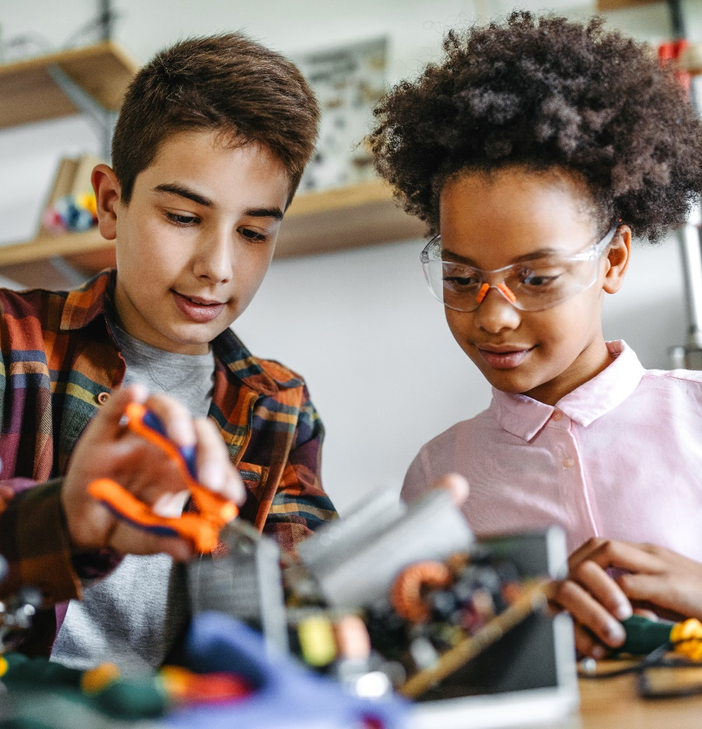
Your BI activities should be…
Meaningfully connected to your research
Innovative
Impactful
Fun!

Slide 57
Common BI Activities
K-12 outreach
Bringing students into the lab
Curriculum development
Broadening participation
Citizen science
Science communications
STEM workforce development
Developing research infrastructure
Notes:
Here are some common types of BI activities.

Slide 58
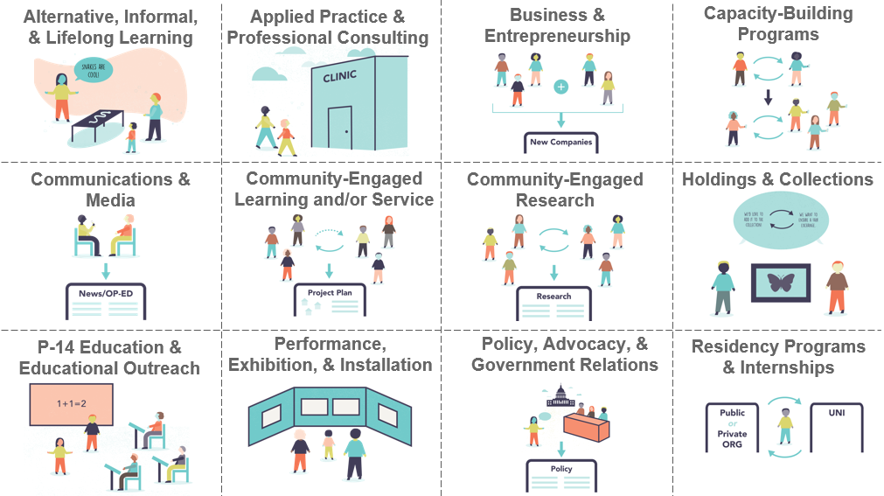
Twelve Domains of Public Engagement
Source: Aurbach, Kuhn, & Niemer, 2019
Notes:
These 12 domains of public engagement come from Elyse Aurbach and her colleagues at the Center for Academic Innovation at the University of Michigan.
They may help to you narrow down what kind of BI activity you want to do with your audience [pause, don’t read].

Slide 59
Worksheet 4: My BI Activity (10 min)
Quickly jot down some ideas:
Given my goals, audiences, settings and partners, what are some BI activities we could do together?

Slide 60
Questions?

Slide 61
https://engage.msu.edu/ways-to-engage/broader-impacts-resources
Notes:
Other sources of ideas for BI activities can be found at this link on the UOE website.

Slide 62
BI Plan
BI PLAN
Goal
Audience
Setting & Partners
Activity
Budget
Evaluation
Notes:
We have covered the first four elements of a solid BI plan: goals, audiences, settings and partners, and activities.
Now we’d like to briefly touch on budgets and evaluation and offer some tips from the experts on writing a great BI plan

Slide 63
5 - Your BI Budget
Be sure to devote sufficient resources to your BI activities!
(~10% of direct costs)
(McFadden, 2019)
Notes:
SR:
Just as reviewers will be evaluating whether you have adequate funding to carry out your research activities, so they will be assessing whether you have adequately funded your BI activities.
A general rule of thumb is about 10% of direct costs.
If you underfund your BI activities, they may think you are not serious about them.

Slide 64
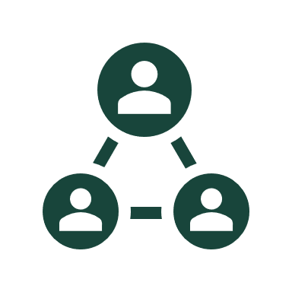
Key Considerations for BI Budgets
Resources
What existing resources or programs can you or your partners leverage?
What new resources will your institution vs. your partners contribute?
People
Who will be involved in conducting the BI activities?
Partners
Undergraduates, graduate students, postdocs
You
Time
How much time will they devote?
How much does their time cost?

Slide 65
Questions?

Slide 66
Evaluating your Broader Impacts
Notes:
MM: Finally, let’s consider how you will assess whether your BI activities have been successful?

Slide 67
Why Evaluate Broader Impacts?
Each proposal submitted to the NSF must include a section about its intended broader impacts and a plan for assessing them.
Notes:
Evaluation of your project is essential. Why?
Because each proposal submitted to the NSF must include a section about its intended broader impacts and a plan for assessing them.

Slide 68
Key Evaluation Questions
Was your BI activity successful?
Were key goals and objectives met?
Was the activity valuable for your audience?
Were your activities appropriate for them?
How did your audience change?
Knowledge, attitudes, skills and behaviors?
Source: Broader Impacts Wizard, https://aris.marine.rutgers.edu/wizard/index.php
Notes:
Your evaluation should be able to answer these questions…

Slide 69
Science Communication Outcomes
Awareness of science
Enjoyment of science
Interest in science
Opinion-forming towards science
Understanding content and process of science
+ Intention/Motivation
+ Behavior
Burns, O'Connor, & Stocklmayer, 2003
Notes:
Here are some expected outcomes from science communications.
I think they are broadly applicable to many BI activities.
The AEIOU (vowels) mnemonic is from Burns and colleagues. [READ].
I have added intentions/motivations and behaviors as outcomes that may be reasonable to expect as well.
These are the kinds of outcomes you might reasonably expect from BI activities that engage the public (but not all do).

Slide 70
Isotopes in Motion Student Survey
After the dance performance, tours and workshops... | Not at all | Slightly | Moderately | Definitely
I am more interested in studying science in school. | ◯ | ◯ | ◯ | ◯
I am more interested in a career in science. | ◯ | ◯ | ◯ | ◯
I am more confident in my ability to succeed in science. | ◯ | ◯ | ◯ | ◯
I am more interested in learning about science out of school (in clubs or other activities). | ◯ | ◯ | ◯ | ◯
I feel more confident that people like me can be scientists or engineers. | ◯ | ◯ | ◯ | ◯
I will explore different science career options. | ◯ | ◯ | ◯ | ◯
Notes:
Here is a draft survey from the postponed Isotopes in Motion event.
It shows a simple method for assessing the kinds of outcomes we just looked at:
Interest and intention/motivation.
It also assesses confidence. This is especially important for URM and females.

Slide 71
Worksheet 5: My Evaluation Plan (10 min)
Quickly jot down some ideas:
How will you I know if my BI activity has been successful?
What are some expected short-term outcomes for my participants?
How might I measure them?

Slide 72
Questions?

Slide 73
How to find an evaluator
Contact Miles (mcnall@msu.edu). He can connect you with MSU, MI and US evaluators

Slide 74
Tips for a Great BI Plan
Developed concurrently with and integrated into the research plan - instead of hastily tacked on at the end
BI language unique to the proposed research plan – instead of recycled “boilerplate” BI language
Partners identified and partnerships established – instead of a “whirlwind romance”
An appropriate budget for BI activities
Clear metrics for success
McFadden, 2019
Notes:
MM

Slide 75
Two Fantastic BI Resources
Notes:
MM: Finally, I want to end by shared two fantastic BI resources…

Slide 76
Designed to:
assist proposal reviewers in evaluating the BI component of NSF proposals
assist proposers with developing their broader impact plans
Available here: https://www.researchinsociety.org/
Notes:
The first is NABI’s BI Guiding Principles Document. It is designed to…
If you are writing a proposal, it’s always good to know what criteria reviewers are using to evaluate it.

Slide 77
The BI Wizard
A website that will help you draft your BI plan!
Notes:
The second resource is the BI Wizard, a website devoted to helping you draft your BI plan.
You will find that we have already covered most of the steps in the Wizard today.
But using the wizard may give you some additional ideas.
[LINK IN CHAT]

Slide 78
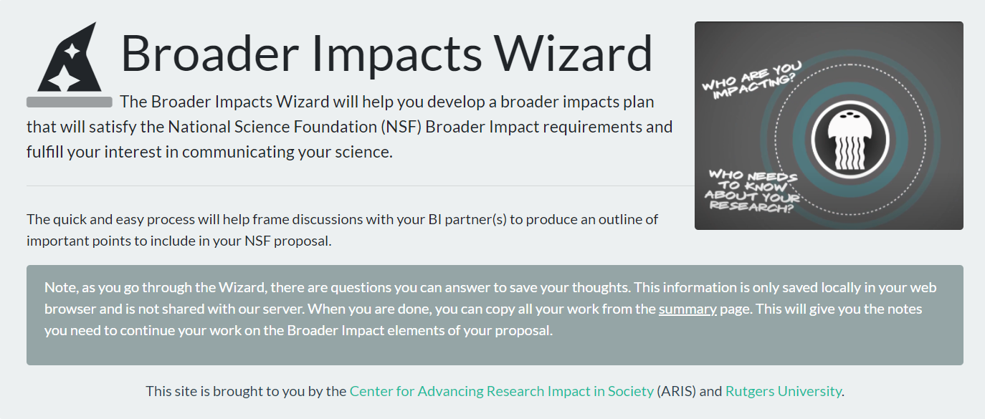
https://www.researchinsociety.org/
Notes:
The BI Wizard guides you step-by-step through the process of creating a BI plan, including evaluating the broader impacts of your research.

Slide 79
Your BI Consultants
Miles McNall – mcnall@msu.edu
Sobha Ramanand - ramanand@msu.edu

Slide 80
Wrap Up
Final Questions? (Use chat)
Slides will be sent to you
Workshop evaluation survey

Slide 81
REFERENCES
Allen, S. (2008). Evaluating exhibitions. In A.J. Friedman (Ed). Framework for Evaluating Impacts of Informal Science Education Projects. Report from a National Science Foundation Workshop. Pp. 42-56. The National Science Foundation, Directorate for Education and Human Resources, Division of Research on Learning in Formal and Informal Settings.
Allen, S. & Peterman, K. (2019). Evaluating informal STEM education: Issues and challenges in context. New Directions for Evaluation, 2019(161), 17-33.
Aurbach, E.L, Kuhn, E., & Niemer, R.K. (2019). “Working Draft 3.0 of the Michigan Public Engagement Framework.”
Bell, P., Lewenstein, B., Shouse, A. W., & Feder, M. A. (2009). Learning Science in Informal Environments: People. Places and Pursuits.
Bevan, Calabrese Barton & Garibay. (2018). Broadening Perspectives on Broadening Participation in STEM. Washington, DC: Center for Advancement of Informal Science Education.

Slide 82
REFERENCES
Burns, T. W., O'Connor, D. J., & Stocklmayer, S. M. (2003). Science communication: a contemporary definition. Public understanding of science, 12(2), 183-202.
deBruyn, J. (2018, June 1). How to nail broader impacts in your next NSF grant. American Society for Microbiology https://www.asm.org/Articles/2018/June/how-to-nail-broader-impacts-in-your-next-nsf-grant)
Centers for Disease Control and Prevention (n.d.) Well-being concepts. https://www.cdc.gov/hrqol/wellbeing.htm
McFadden, B. (2019). Broader Impacts of Science on Society. Cambridge: Cambridge University Press.
Risien, J., & Storksdieck, M. (2018). Unveiling impact identities: A path for connecting science and society. Integrative and comparative biology, 58(1), 58-66.
Stevens, R., Bransford, J., & Stevens, A. (2005). The LIFE Center Lifelong and Lifewide Learning Diagram. Seattle, WA: LIFE Center. http://life-slc.org/about/citationdetails.html

